Slide 1
SQOOP-Project
Big data analytics track Project – Submitted by Shalini gupta

Slide 2
Profile Details
Name: Shalini Gupta
Email ID: shalini2501@gmail.com
Course Enrolled: Big Data Analytics
Project Name: SQOOP

Slide 3
Project Details
Domain: Working with SQOOP
Topic: Ingestion using SQOOP
Technology used: SQOOP, Hbase, HIVE, MYSQL

Slide 4
Project Introduction
SQOOP is a ingestion tool for HDFS to RDBMS,or any other source and Vice-versa.
Dataset: petrol_dataset and export_dataset

Slide 5
Dataset Description
Meta Data of petrol_dataset:
DistrictID
Distributer name
Buy rate (million)
Sell rate(million)
volumeIN(millioncubic litter)
volume OUT(millioncubic litter)
Year

Slide 6
Question 1: Use MySQL table sqoopex.petrol_data and write a sqoop query to create a corresponding hbase table in hbase.
Step 1:Create hbase table using the following command in hbase:
create 'petrol_dataImport', {NAME=> 'distributerInfo’}
Step 2: Command used for import to hbase:
sqoop import \
--connect jdbc:mysql://ip-172-31-20-247/sqoopex \
--username sqoopuser \
--password NHkkP876rp \
--table petrol_dataset \
--hbase-table petrol_dataImport --column-family distributerInfo --hbase-row-key DISTRICTID \
-m 1

Slide 7
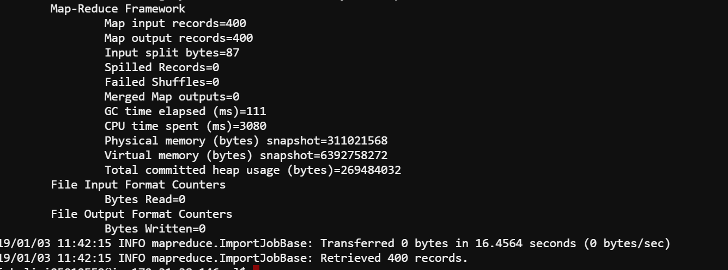
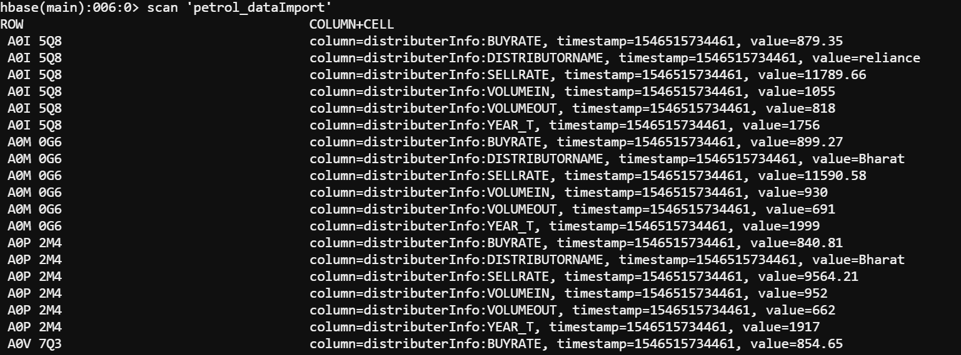
Hbase table status:

Slide 8
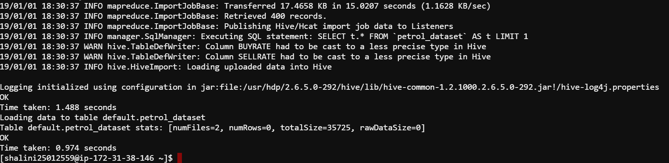
Question 2: Use MySQL table sqoopex.petrol_data and write a sqoop query to create a corresponding hive table in hive.
Command used for import to Hive:
sqoop import \
--connect jdbc:mysql://ip-172-31-20-247/sqoopex \
--username sqoopuser \
--password NHkkP876rp \
--table petrol_dataset \
--m 1 \
--hive-import

Slide 9
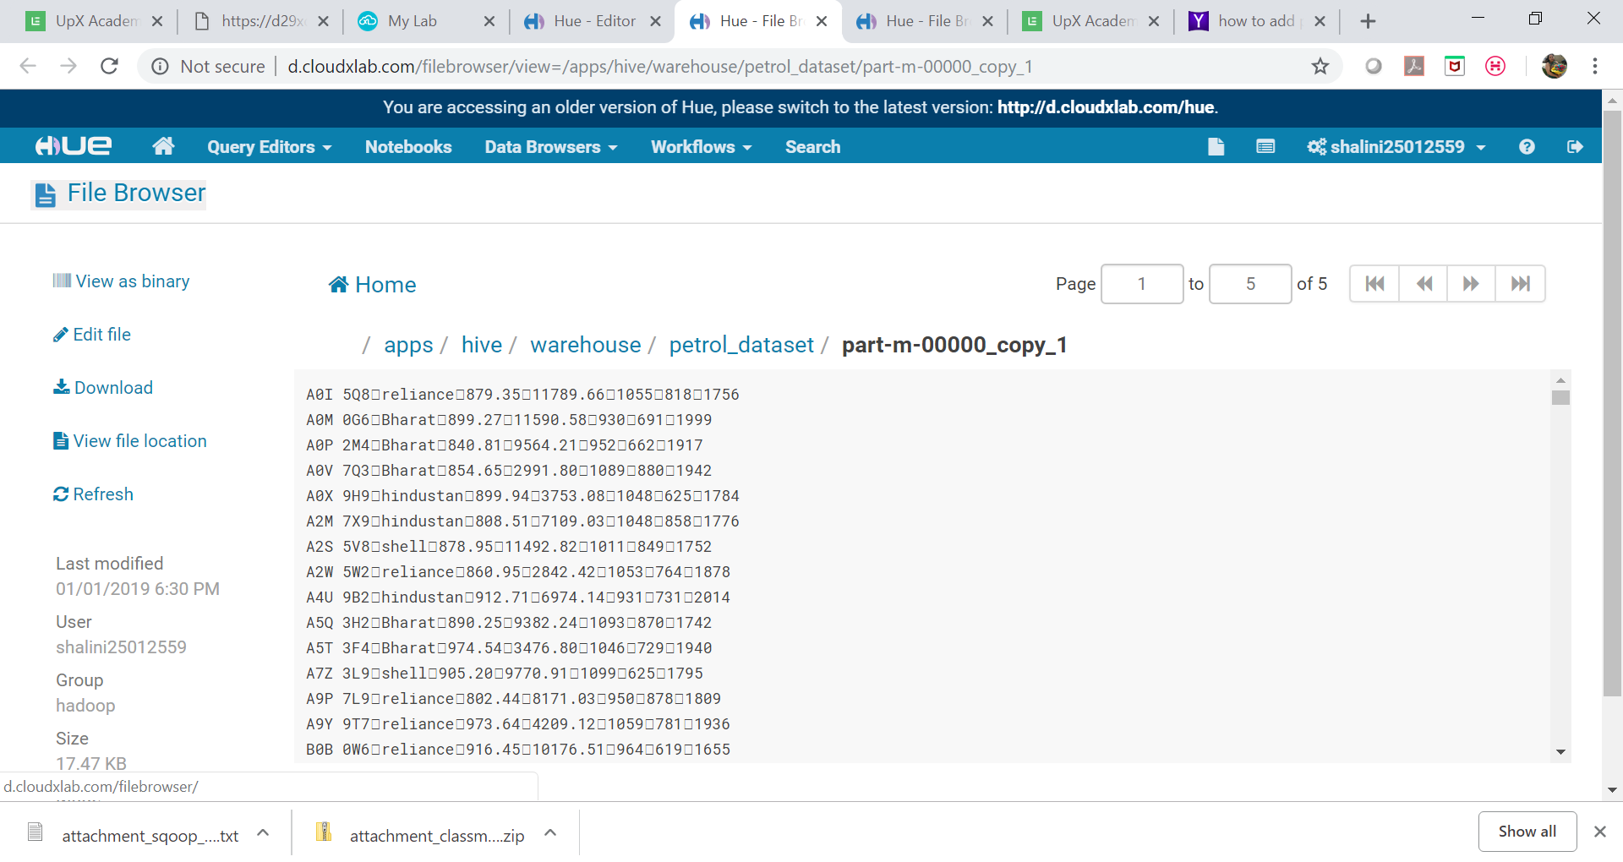
Status on Hive

Slide 10
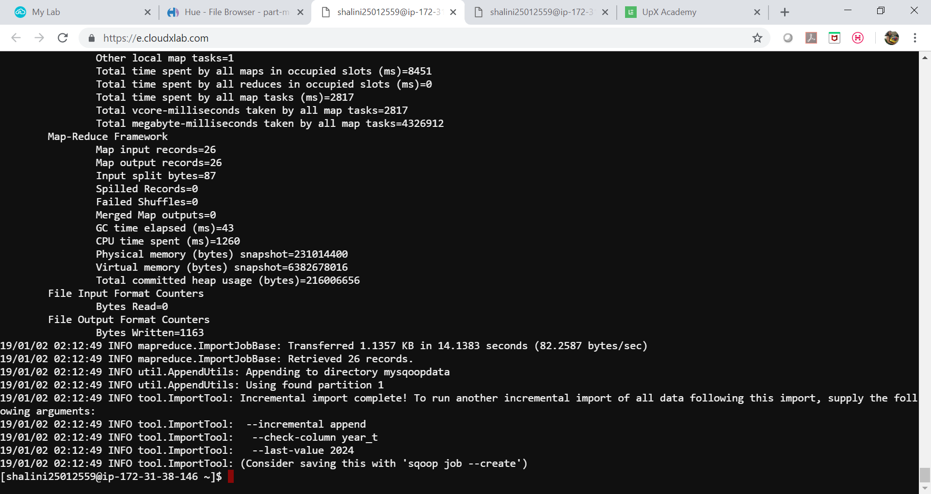
Question 3: Use MySQL table sqoopex.petrol_data and write sqoop query to import records after year 1998. Use incremental feature.
Command used for import (incremental feature):
sqoop import \
--connect jdbc:mysql://ip-172-31-20-247/sqoopex \
--username sqoopuser \
--password NHkkP876rp \
--table petrol_dataset \
--m 1 \
--check-column year_t \
--incremental append \
--last-value 1998 \
--target-dir /user/shalini25012559/mysqoopdata

Slide 11
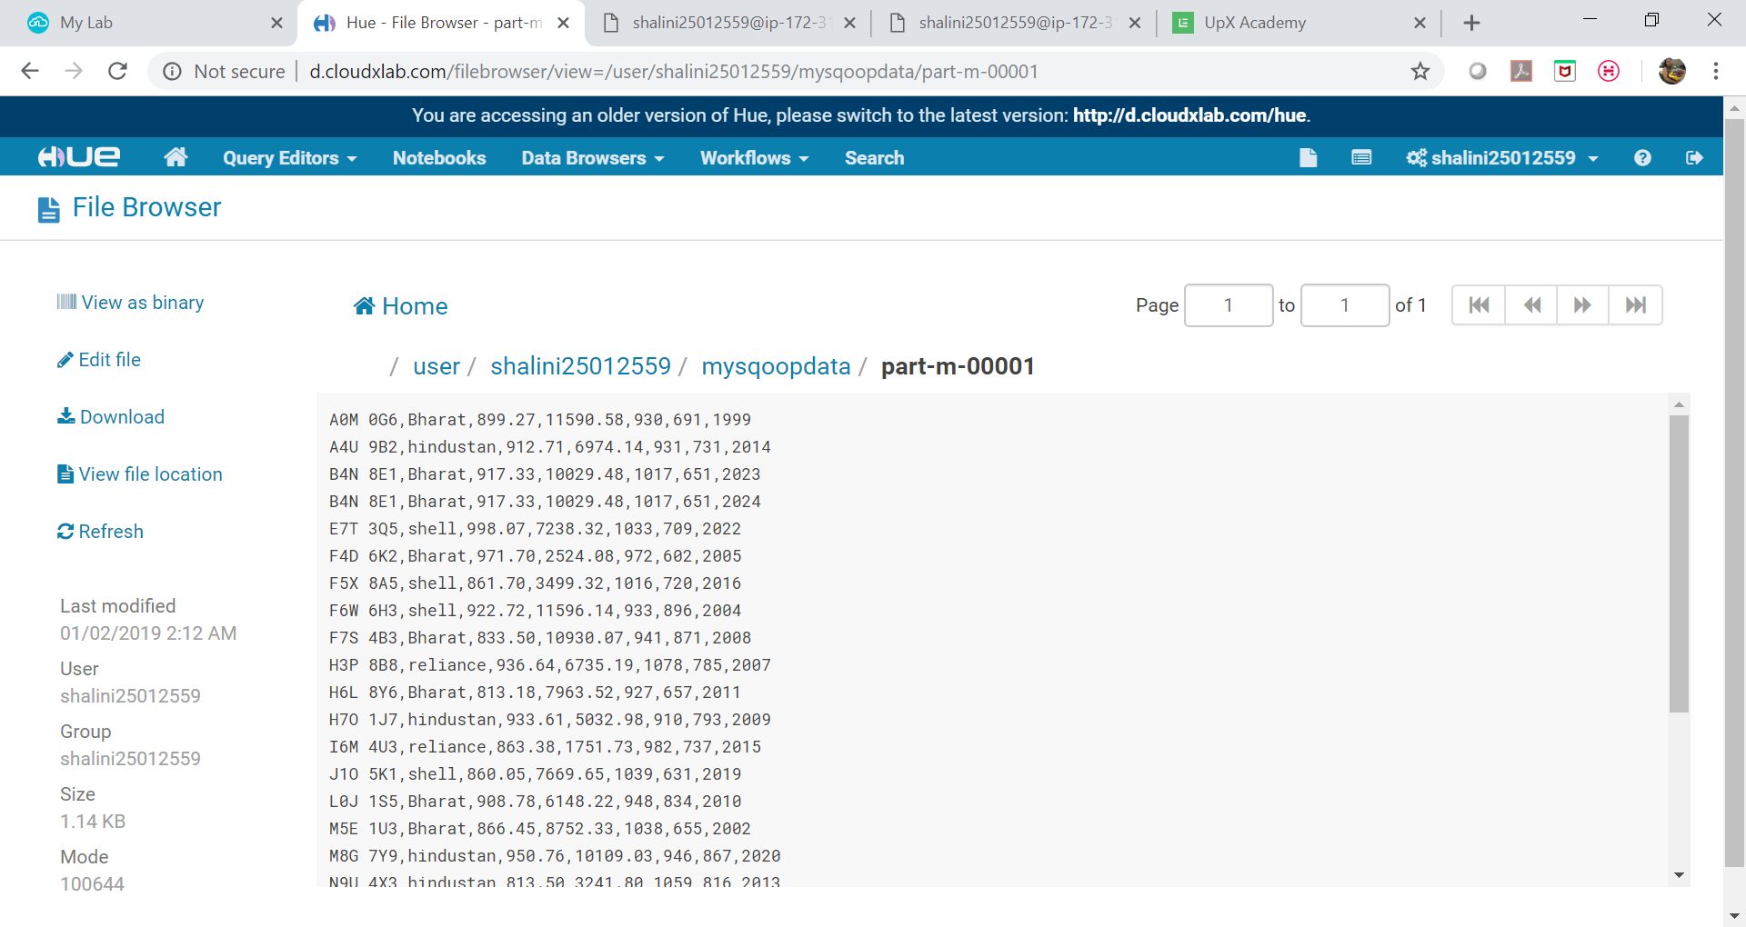
Status on HDFS

Slide 12
Question 4: Transfer the HDFS data named 'export_dataset' to MySQL table sqoopex.exported_data. Use export_dataset.txt
Command to create tables in sqoopex database under MySQL:
create table exported_data(
rowID varchar(37) NOT NULL,
col1 varchar(15) NOT NULL,
col2 varchar(8) NOT NULL,
col3 date NOT NULL,
PRIMARY KEY(rowID)
);
create table exported_data_stg(
rowID varchar(37) NOT NULL,
col1 varchar(15) NOT NULL,
col2 varchar(8) NOT NULL,
col3 date NOT NULL,
PRIMARY KEY(rowID)
);

Slide 13
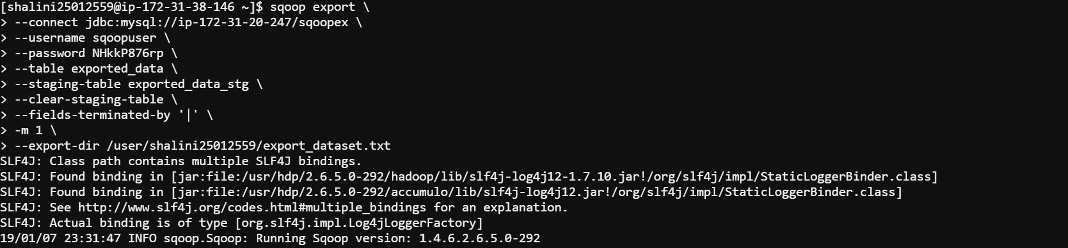
Command to export the data:
sqoop export \
--connect jdbc:mysql://ip-172-31-20-247/sqoopex \
--username sqoopuser \
--password NHkkP876rp \
--table exported_data \
--staging-table exported_data_stg \
--clear-staging-table \
--fields-terminated-by '|' \
-m 1 \
--export-dir /user/shalini25012559/export_dataset.txt

Slide 14
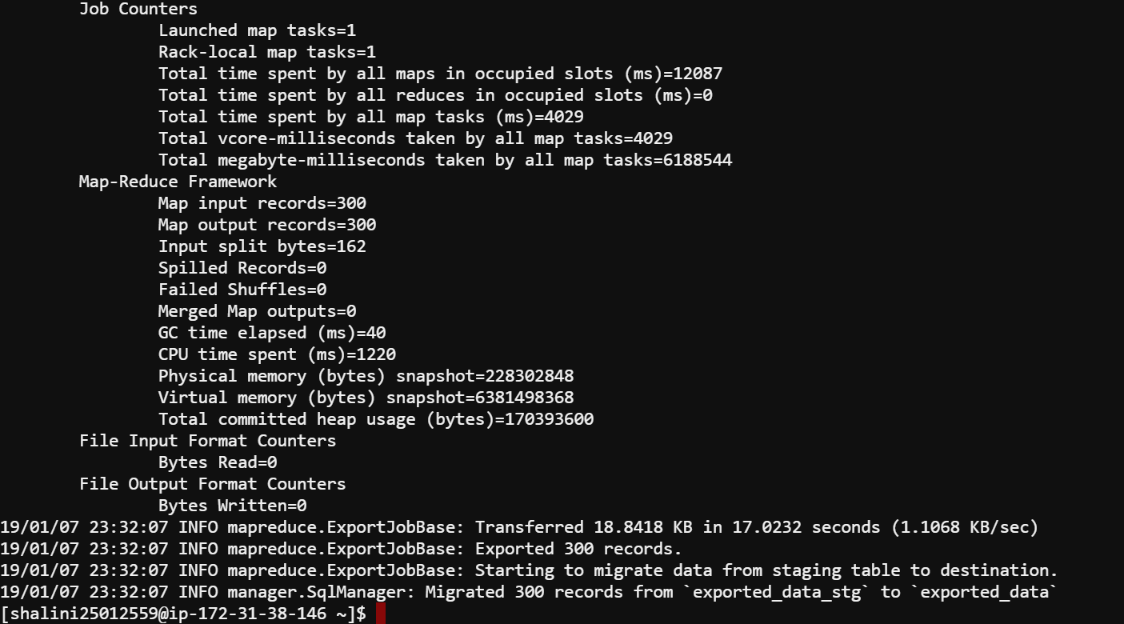

Slide 15
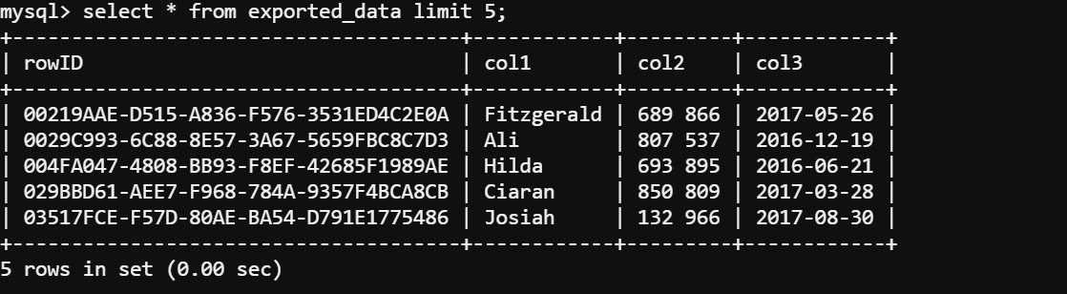
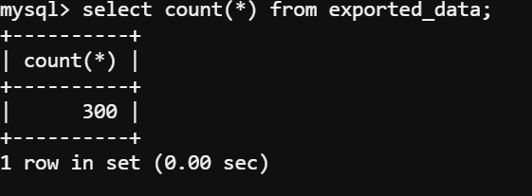
Status on MySQL After export command:

Slide 16
Thank you!!

